Slide 1
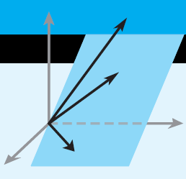
VECTOR SPACES
Chapter # 03 & 04: “Elementary Linear Algebra” by Howard Anton & Chris Rorres
Course Instructor:
Osama Bin Ajaz
Lecturer, Sciences & Humanities Dept.,
FAST-NUCES, Main Campus, Karachi

Slide 2
EUCLIDEAN VECTOR SPACES

Slide 3
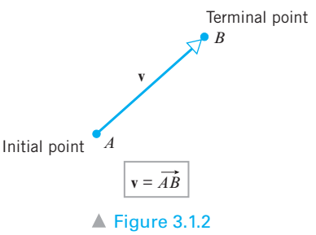
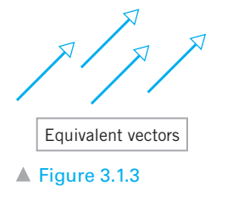
3.1: Vector in 2-Space, 3-Space & n-Space
Scalars are quantities that are described by a numerical value alone. For example: temperature, length, and speed etc.
Vectors are quantities that require both a number and a direction. For example: velocity, force etc.
Geometric Vectors:
Equivalent Vectors: Same length & direction even though they may be in different positions.

Slide 4
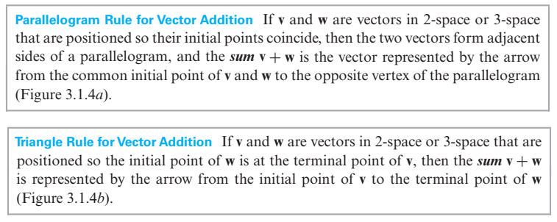
Vector Addition

Slide 5
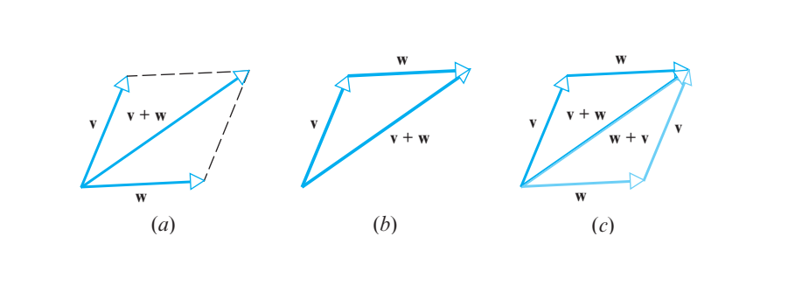
Vector Addition (Geometrical View)
Figure 3.14:
Parallelogram Rule
for Vector Addition
Triangle Rule for Vector Addition
v + w = w + v

Slide 6
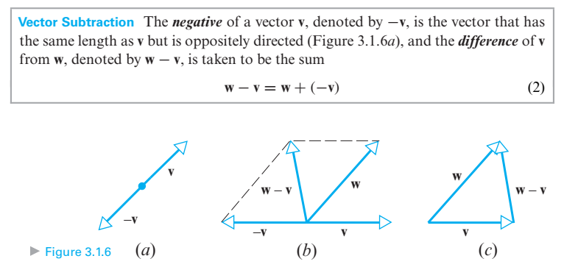
Vector Subtraction

Slide 7
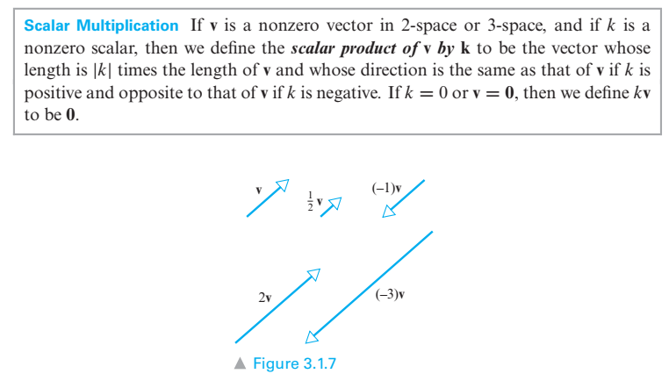
Scalar Multiplication

Slide 8
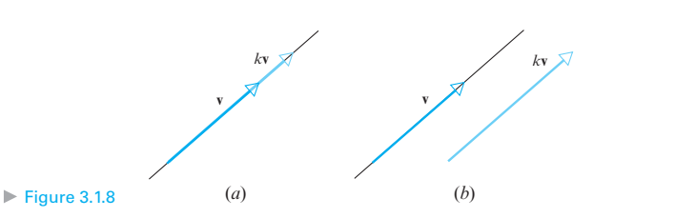
Parallel and Collinear Vectors
Suppose that v and w are vectors in 2-space or 3-space with a common initial point. If one of the vectors is a scalar multiple of the other, then the vectors lie on a common line, so it is reasonable to say that they are collinear.
The terms parallel and collinear mean the same things when applied to vectors.

Slide 9
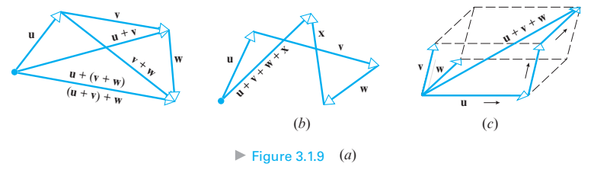
Sum of three or more vectors
Vector addition satisfies the associative law for addition: u + (v + w) = (u + v) + w
A simple way to construct u + v + w is to place the vectors “tip to tail” in succession and then draw the vector from the initial point of u to the terminal point of w.

Slide 10
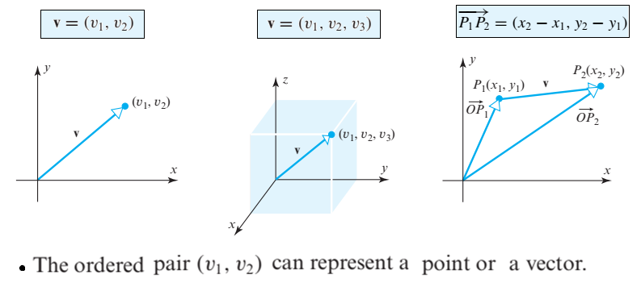
Vectors in Coordinate Systems
Components of vector v

Slide 11
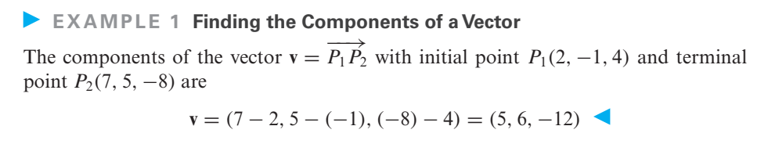
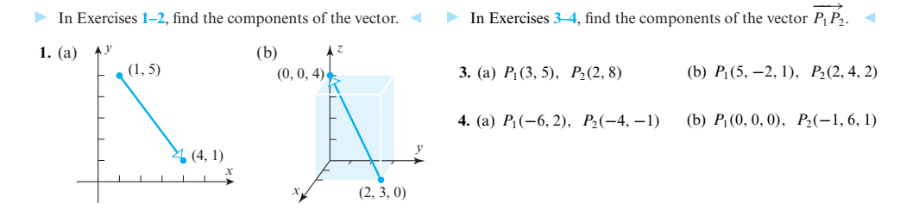
3a. (-1, 3)
3b. (-3, 6, 1)
4a. (2, -3)
4b. (-1, 6, 1)
(a) (3, -4) & (b) (-2,3,4)

Slide 12
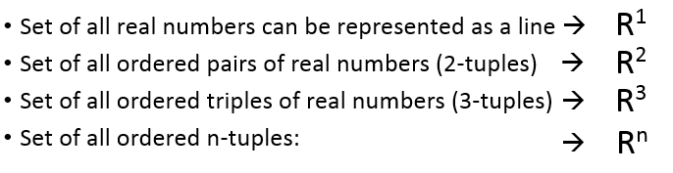
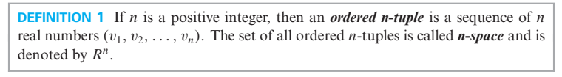
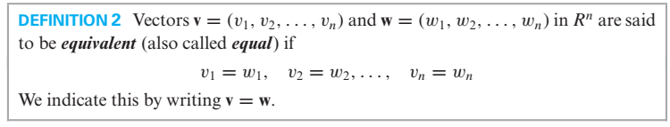
n-Space

Slide 13
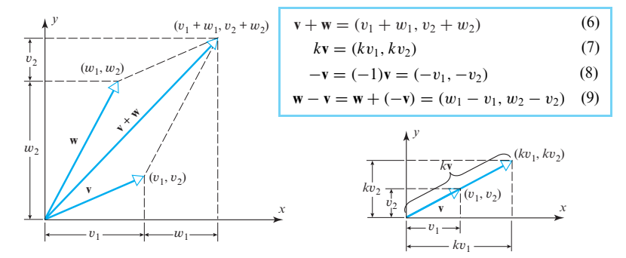
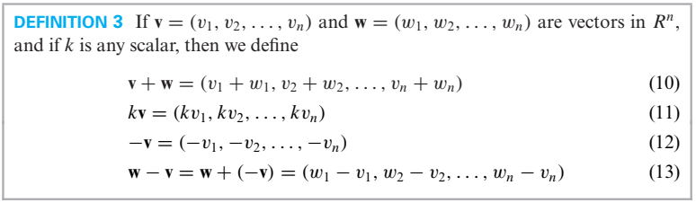

Slide 14
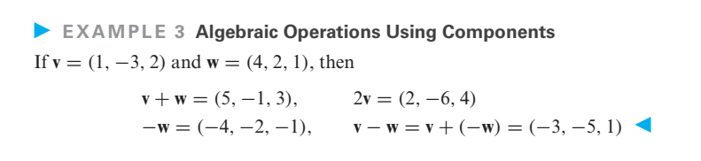
Algebraic Operations Using Components

Slide 15
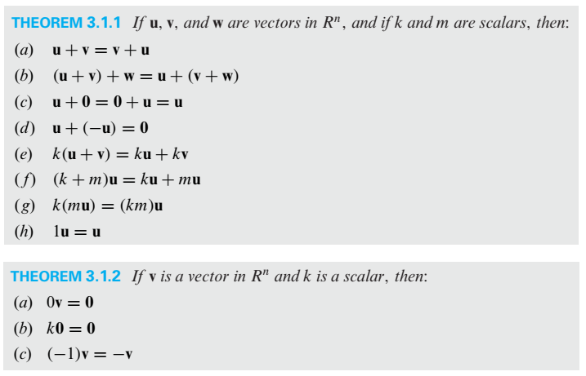
Algebraic Operations Using Components (Contd.)

Slide 16
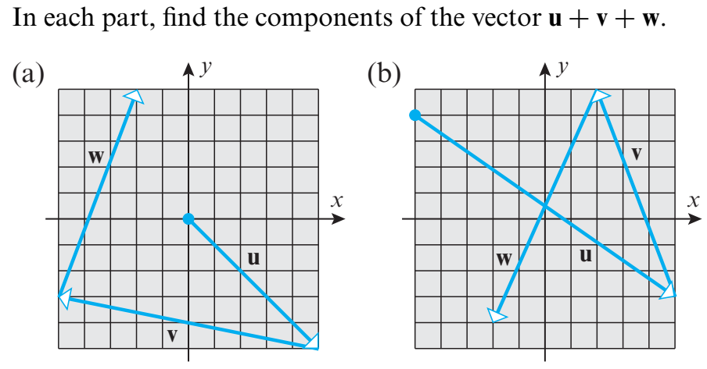
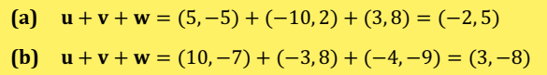
( -2,5)
(0, 0)
(-5, -3)
(5, -5)

Slide 17
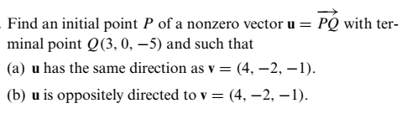
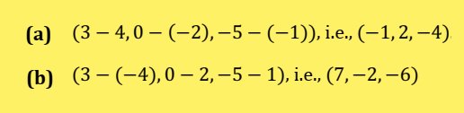

Slide 18
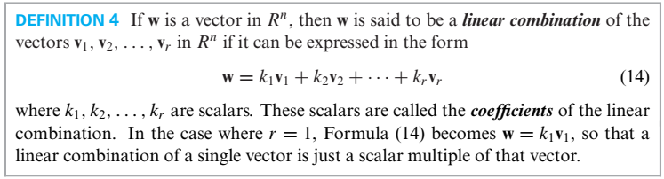
Linear Combinations

Slide 19
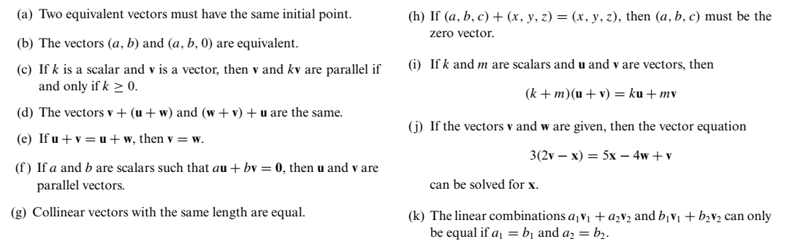
True-False Exercises
FALSE
TRUE
FALSE
FALSE
FALSE
TRUE
TRUE
TRUE
FALSE
FALSE
FALSE

Slide 20
3.2: Norm, Dot Product, and Distance in n-space

Slide 21
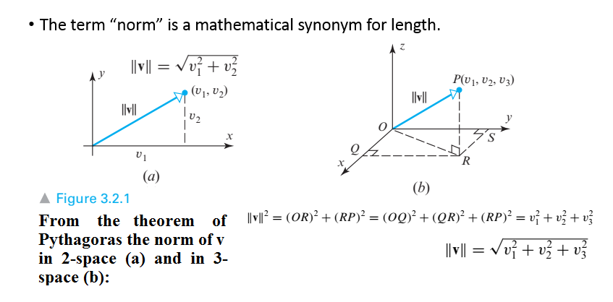
Norm of a Vector

Slide 22
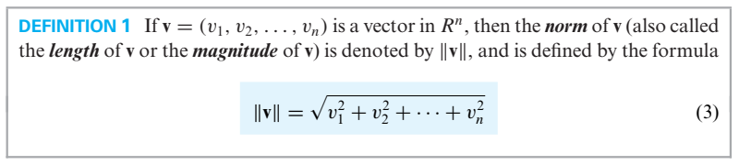
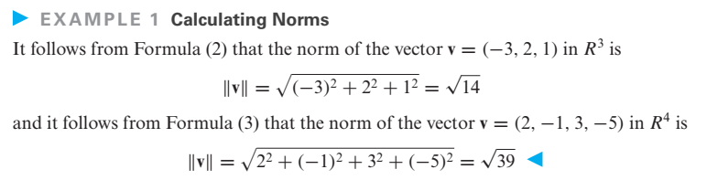
Norm of a vector in n-space

Slide 23
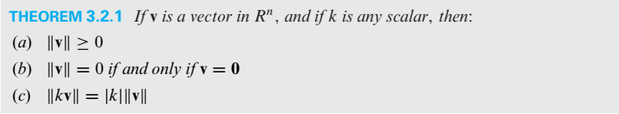
Distances are non-negative
The zero vector is the only vector of length zero.
Multiplying a vector by a scalar multiplies its length by the absolute value of that scalar.

Slide 24
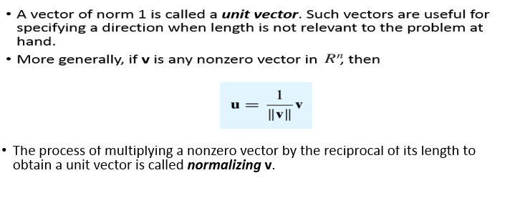
Unit Vector

Slide 25
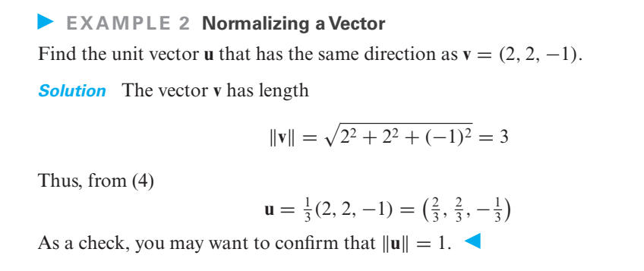

Slide 26
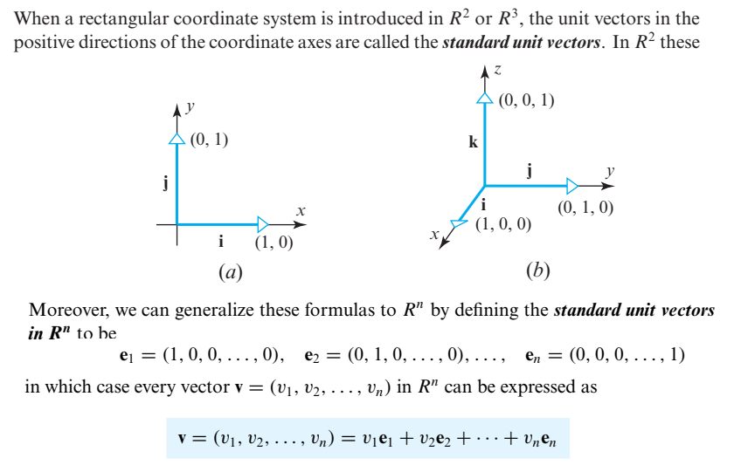
The standard Unit Vector

Slide 27
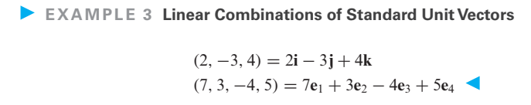

Slide 28
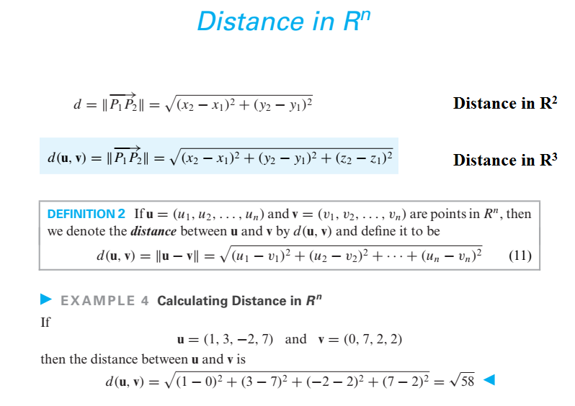

Slide 29
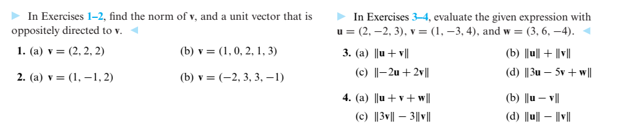
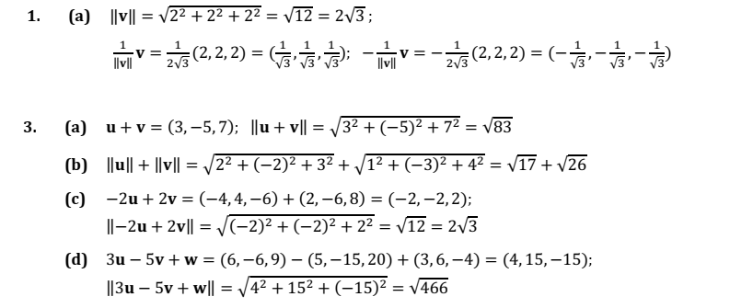

Slide 30
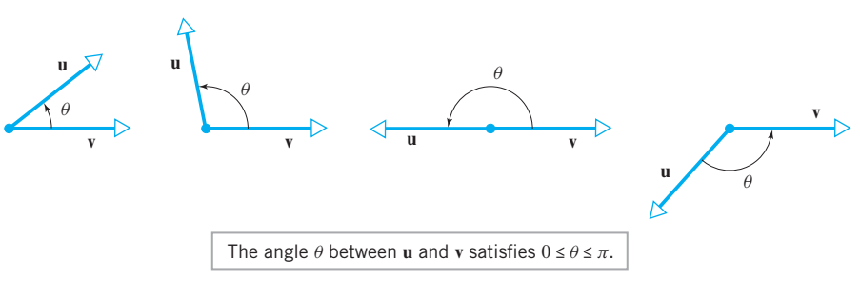
Angle between two non zero vector

Slide 31
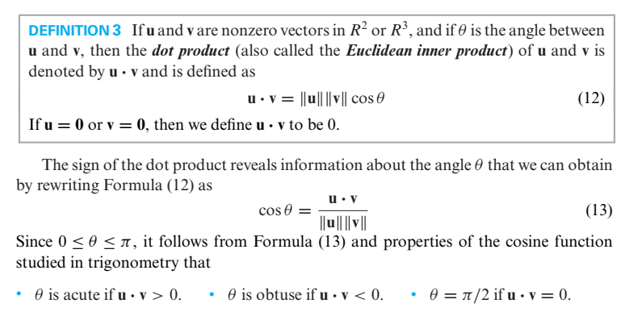
Dot Product

Slide 32
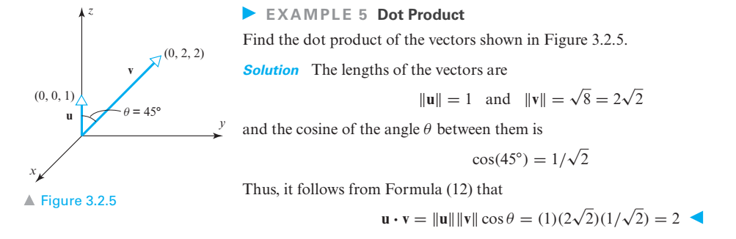

Slide 33
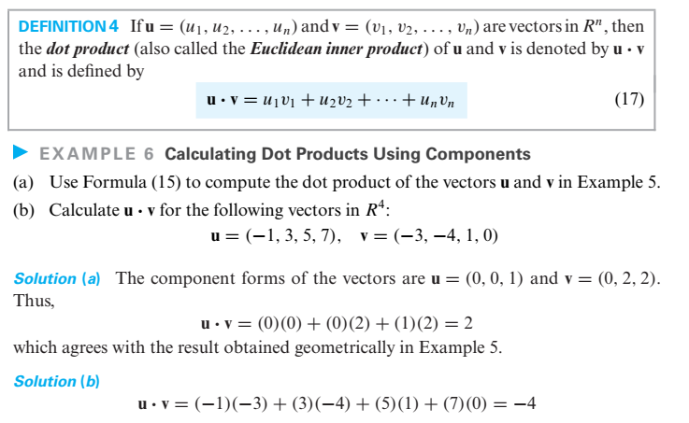
Components form of dot product

Slide 34
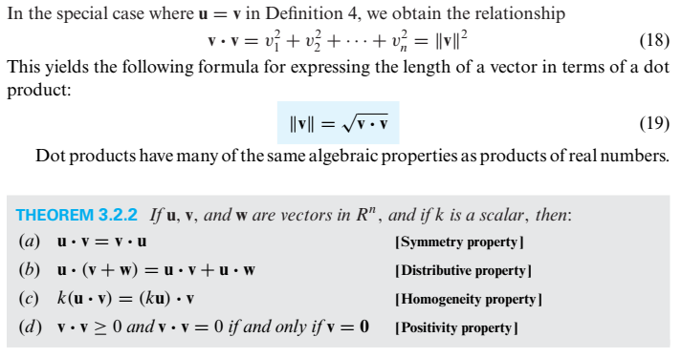
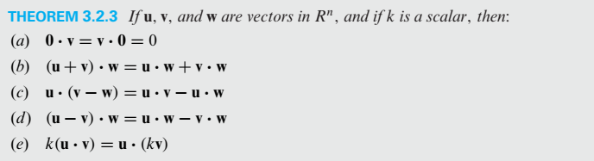
Algebraic Properties of Dot Product

Slide 35
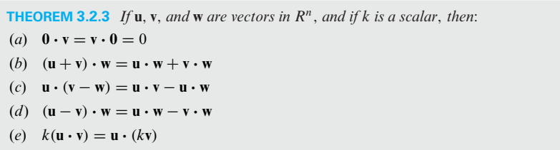
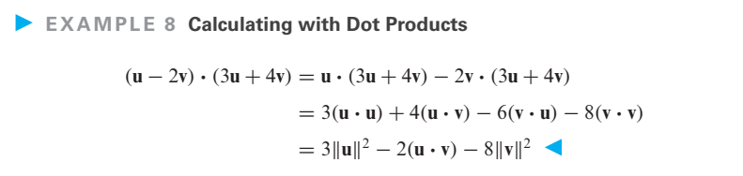
Algebraic Properties of Dot Product (Contd.)

Slide 36
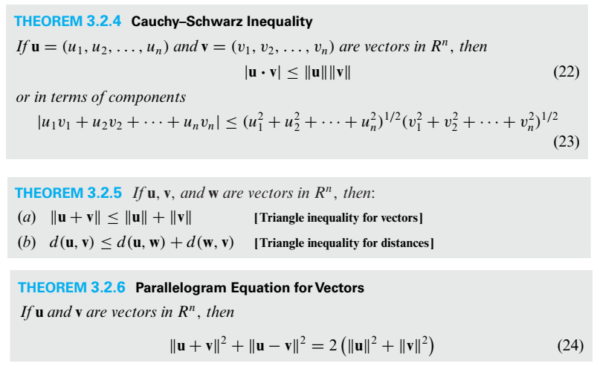
Some other Theorems

Slide 37
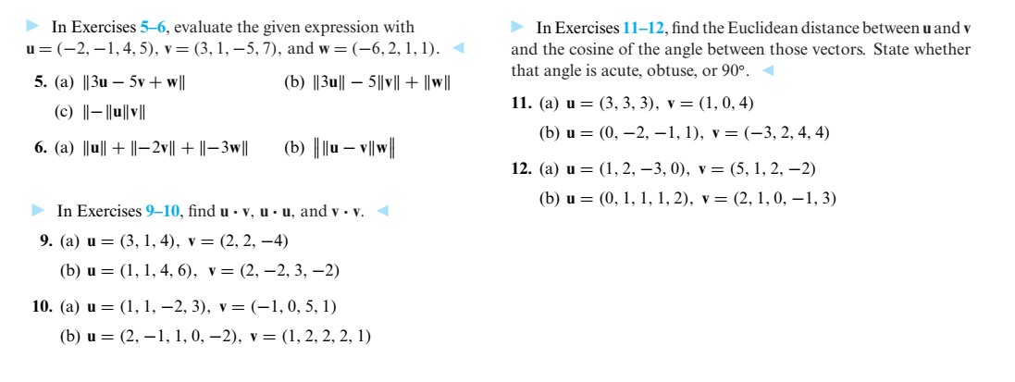
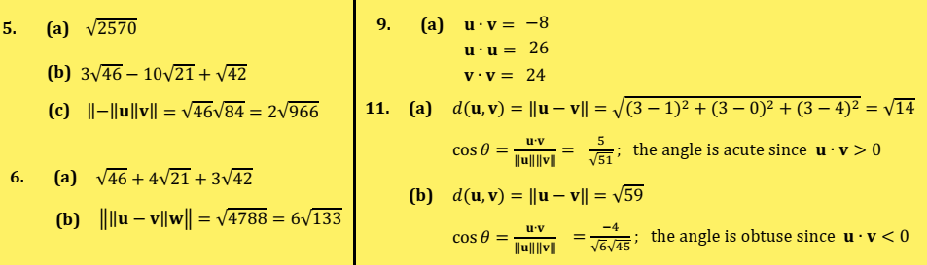

Slide 38
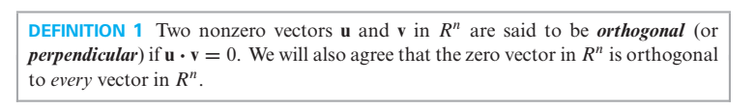
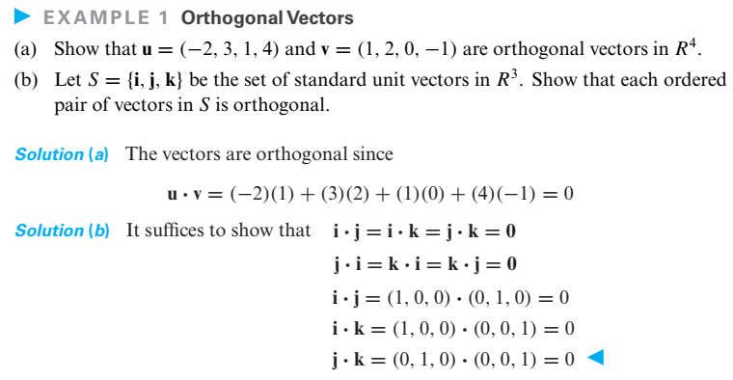
Orthogonality

Slide 39
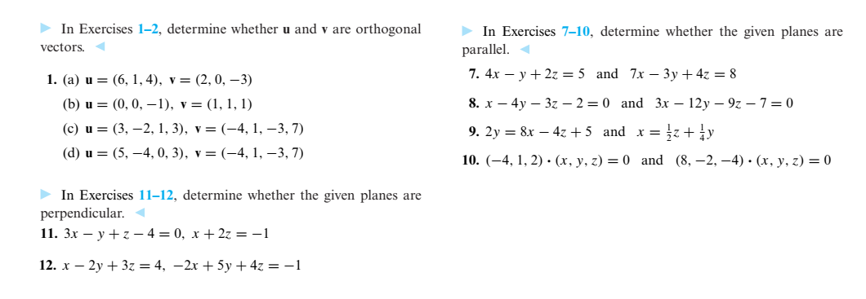
Orthogonal
Non-Orthogonal
Non-Orthogonal
Non-Orthogonal
Not parallel
Parallel
Not perpendicular
Not parallel
Not perpendicular
Parallel

Slide 40
GENERAL VECTOR SPACES (Algebraic properties of vectors in R^{n} as axioms)

Slide 41

Vector Space
Nonempty set of objects with two operations: Addition & Scalar Multiplication
Closure under addition
Closure under Scalar Multiplication

Slide 42



Slide 43


Slide 44


The set V is closed under addition and scalar multiplication.
Axioms 2, 3, 4, 5, 8, 9, 10 satisfied by Theorem 1.4.1.

Slide 45


Slide 46


Slide 47

The first nine vector space axioms are satisfied.
However, Axiom 10 fails to hold for certain vectors. For example,
if u = (u1, u2) is such that u2 ≠ 0, then
1u = 1(u1, u2) = (1.u1, 0) = (u1, 0) ≠ u
Thus, V is not a vector space with the stated operations.

Slide 48


Slide 49


Slide 50

TRUE-FALSE
TRUE
FALSE
FALSE
FALSE
TRUE
FALSE

Slide 51





Slide 52

Determine whether each set equipped with the given operations is a vector space.
Vector Space
Vector Space
Vector Space
Axioms 6 failed
Vector Space
Vector Space
Vector Space
Axioms 8 failed
Vector Space
Axioms 6 failed

Slide 53

Subspaces
Axiom 1—Closure of W under addition Axiom 4—Existence of a zero vector in W Axiom 5—Existence of a negative in W for every vector in W Axiom 6—Closure of W under scalar multiplication
(these are not inherited from V)
The vectors u and v are in W, but the vectors u + v and ku are not.

Slide 54



Slide 55


Slide 56


Slide 57


Slide 58



Slide 59



Slide 60



Slide 61


The Hierarchy of Function Spaces

Slide 62


Building Subspaces

Slide 63


Slide 64


Slide 65





`

Slide 66


Slide 67




Notes:
DYS

Slide 68


Notes:
DYS

Slide 69



QUIZ – II (31/10/18) (Max. Marks = (7+3+6) points
(1) Use the adjoint method to find the inverse of the given matrix, if it exists:
(2)
Notes:
Quiz-II section B, dated: 5/10/18

Slide 70


